Slide 1

RRED to Counter LDoS
- 1705045

Slide 2
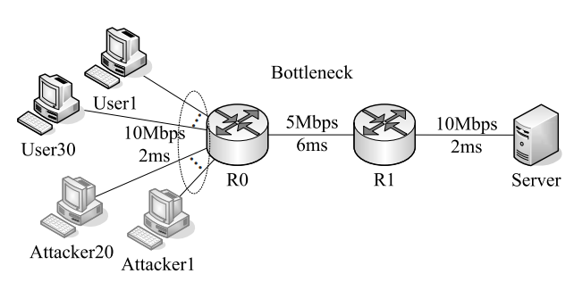
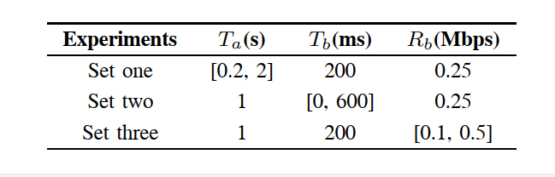
LDoS in Reference Letter

Slide 3
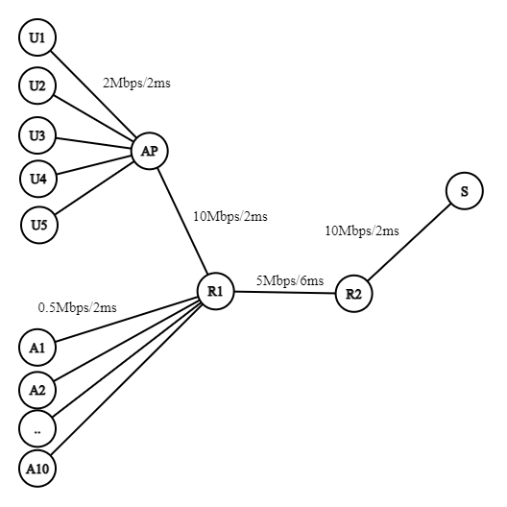
My Topology
Wireless (802.11)
10.0.0.0
RED Queue Disc
Flows:
Users to Server. (5)
Attackers to Server. (10)
10.1.4.0
10.1.2.0
10.1.1.0
Wired
10.1.5.0

Slide 4
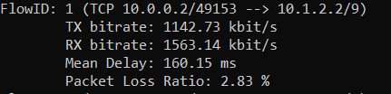
Metrics Without LDoS
Average throughput calculated at TCP Sink: 3.30435 Mbit/s.
- For RRED Queue Disc:
Packets received: 5860
Packets/Bytes enqueued: 5761
Packets dropped: 99
Drop ratio = 99/5860 = 1.68%
- For Flow (U1-to-Server):

Slide 5
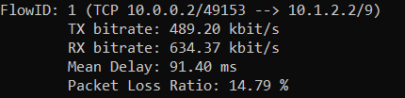
Metrics With LDoS
Average throughput calculated at TCP Sink: 1.43432 Mbit/s. (Became 43%)
- For RRED Queue Disc:
Packets received: 9998
Packets/Bytes enqueued: 8911
Packets dropped: 1087
Drop ratio = 1087/ 9998 = 10.87%
- For Flow (U1-to-Server):

Slide 6
THANK YOU

